Slide 1






International Turnkey Systems
Islamic Finance in Digital Age

Slide 2

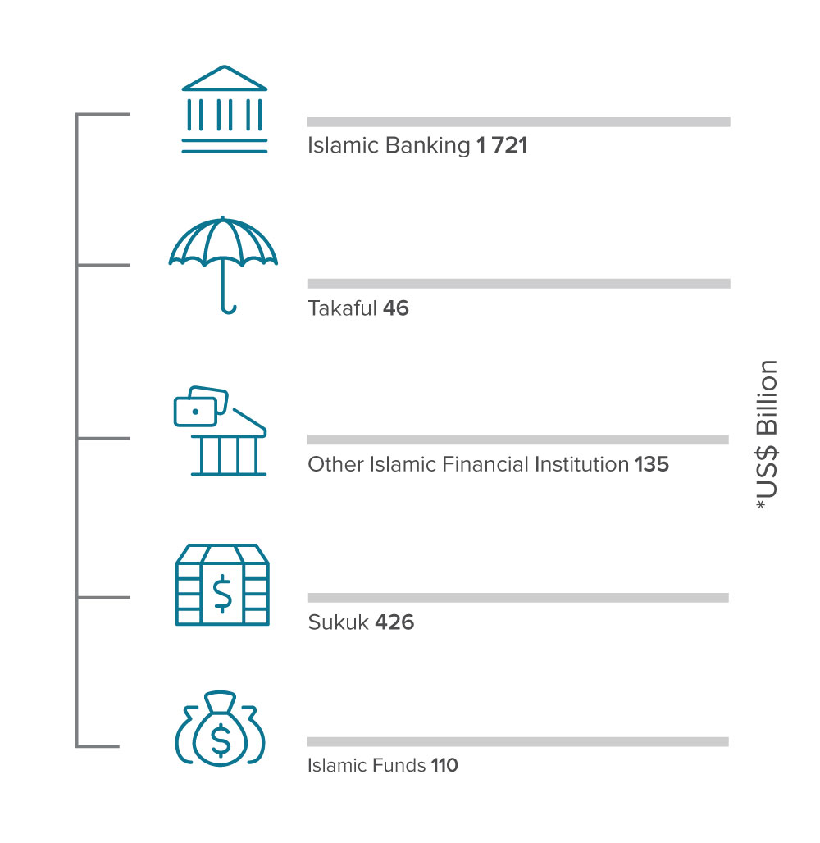

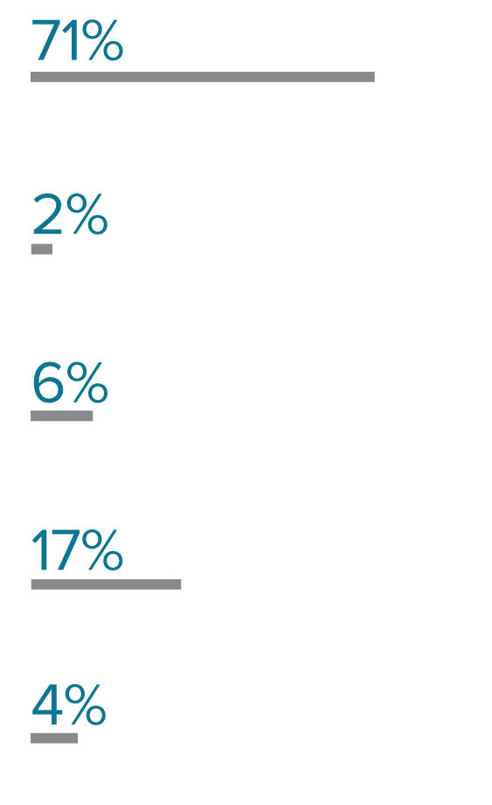
Islamic Banking
Worldwide
US$
1.72
Trillion Total Islamic Banking Assets in 2017
505
Total Islamic Banks in 2017
(including windows)
Total Islamic Finance Assets US$ 2.4 Trillion
82%
Global Islamic Banks Reported Profit 2017
6%
Share of Islamic Banking Assets in Total Global Banking Assets in 2017
Global Islamic Finance Assets Distribution 2017
Reuters Islamic finance development report2018
Notes:
Report source
Global islamic

Slide 3
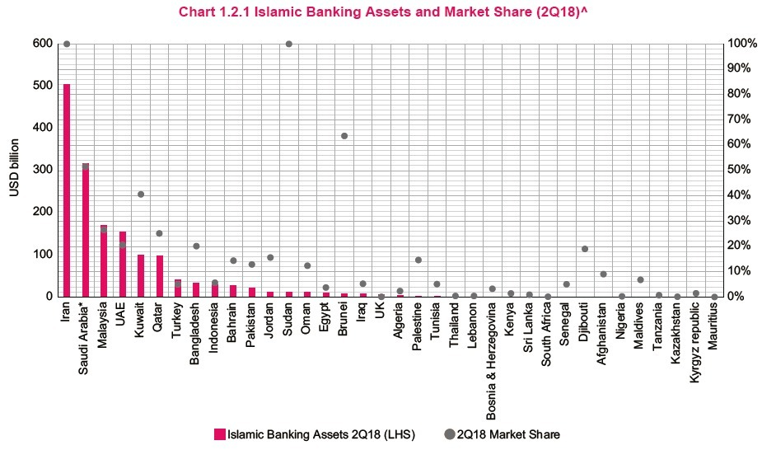
Islamic Banking
Most Developed Countries
Islamic Financial Services Industry Stability Report 2019 - IFSB
Notes:
Islamic Market share calculated from total banking assets for each country
Report source
Global islamic

Slide 4

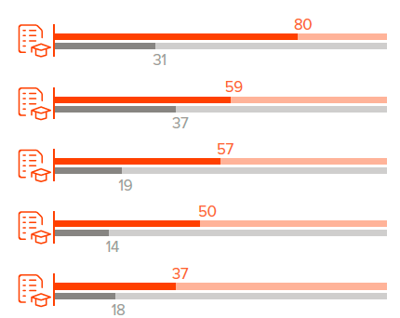
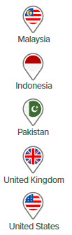
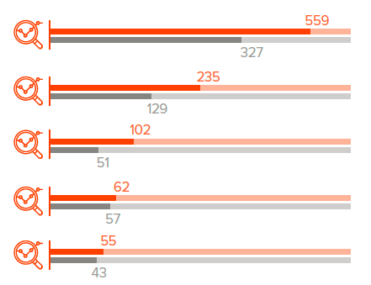
Islamic Banking
Education & Research
Top Countries in Islamic Finance Education 2017
Top Countries in Islamic Finance Research Between 2015 and 2017
Reuters Islamic finance development report2018
Notes:
Islamic finance knowledge is assessed through education and research, which are the main building blocks for any knowledge-based industry. These are the input factors needed to achieve depth and efficiency in the Islamic finance industry, and provide the foundation on which a fully qualified workforce can spur economic growth.
As shown big countries such as UK and USA being leading and part of the top 5 in learning and searching about Islamic finance , proves that worldwide finance sector is redirecting towards Islamic finance.

Slide 5
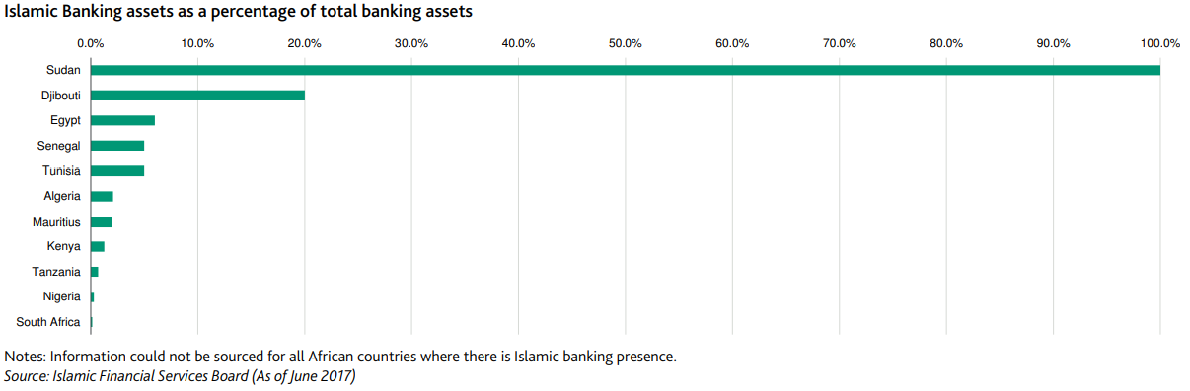
Islamic Banking
In Africa
US$
27.1
Billion Total Islamic Banking Assets in Africa 2017
+80
Islamic Financial Institutions in Africa 2017
1.7%
Islamic Banking Assets of Total African Banking Assets
47%
Of the African Population are Muslims
Islamic Finance - Africa: Promising growth prospects for Islamic finance in 18 African countries - MOODY'S INVESTORS SERVICE
Islamic Financial Services Board (as of June 2017)

Slide 6
Digital Banking
In Africa
About 40% of African banking customers prefer digital channels for transactions; with higher percentages in higher-income segments
** Agent Banking included in mobile channels
Roaring to life: Growth and innovation in African retail banking -www.mckinsey.com

Slide 7

Islamic Banking
Key Driving Pillars
Encouraging Financial Services for SMEs
Infrastructure & Social Development Funding
Motivate the Investments from Islamic Banking Leaders
Improve Financial Inclusion
Notes:
Improve financial inclusion – by attracting fund from Muslims mainly which presents 47% on Africa population
Encouraging Financial Services for SMEs – by providing new resources or activities like Murabha, Ijara with better deal setup that encourages SMEs
3. Infrastructure & social development funding
4. As KSA, UAE, Kuwait

Slide 8

WHO
WE ARE?
1981
Was established by Kuwait Finance House (KFH) with 1200+ employees
2000
ITS opened its development center in Cairo, Egypt with more the 600 employees
ITS has more than
60
customers across the world

Slide 9


Our
Customer Distribution
Islamic Banks Represents 70% of ITS customers
30% Are Fully Digitalized Banks
ASIA
IRAQ,BAHRAIN, OMAN, UAE
KSA, MALAYSIA, SYRIA, QATAR, LEBANON, KUWAIT, TAJIKISTAN
AFRICA
NAMIBIA, NIGERIA, SUDAN, EGYPT, GHANA, ZIMBABWE, UGANDA, MOROCCO, MAURITANIA, ALGERIA, LIBYA
AMERICA
CAYMAN ISLANDS
ANTIGUA
TRINIDAD & TOBAGO
Islamic Bank
Commercial Bank

Slide 10




Our
WAYS IN PROVIDING ISLAMIC SOLUTIONS
Full Fledge Islamic Finance
Islamic Window
Islamic Products
Cost Effective Package for Fully Fledged Islamic Banks
Successful Conversion to Islamic ‘ Shari’ah Compliant’ Operations
A separate department with added value Islamic Products/Services within the Conventional Banks operates under Shari’ah Advisory Board Guidance.
Providing Islamic Products through the existing Conventional bank’s system.
ETHIX Suite
ETHIX Suite
ETHIX Suite
Digital Banking
Dash- board &
Reports
Digital Banking
Dash- board &
Reports
Islamic Finance
Dash- board &
Reports
Branch Automation
Islamic
Finance
Branch Automation
Islamic
Finance
Bank Backend
PCD
Bank Backend
PCD
Bank Backend
PCD
Conventional Bank System
Conventional Bank System

Slide 11

Our
Digital Footprint
Main Features
XTM – Video Branch
Notification Engine
Mobile/Tablet
Customer onboarding
Internet - Retail
Value Added Features
Smart Watch
Augmented Reality
Internet - Corporate
Digital Banking Back-office
Trade Operations
Budget and Goal Setup
Value Added Modules (Integration)
E-Finance Portal
Open Banking
Mobile Wallet
Digital Banking
Footprint
Payment (NFC, QR, Blockchain and integration with payment gateway)
Artificial Intelligence
Chatbot/Video Chat
Gamification

Slide 12
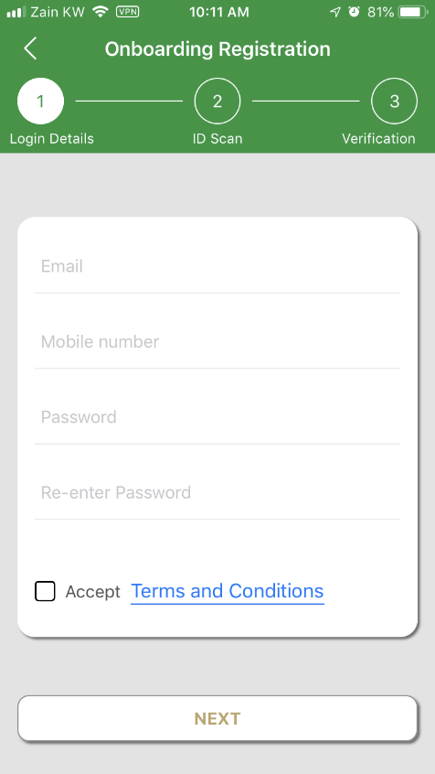
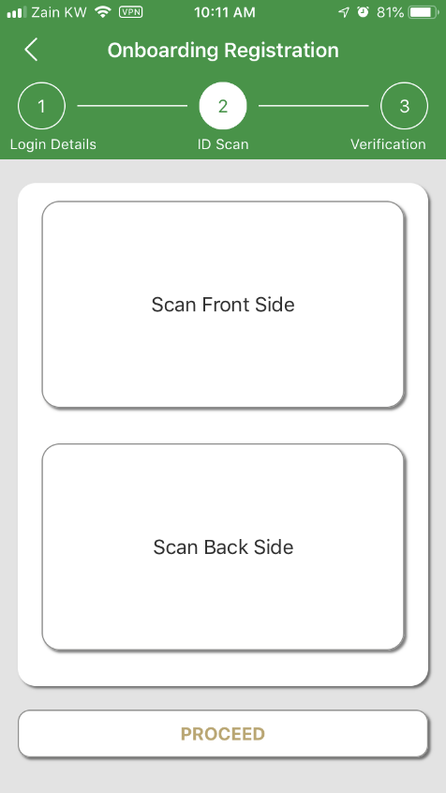
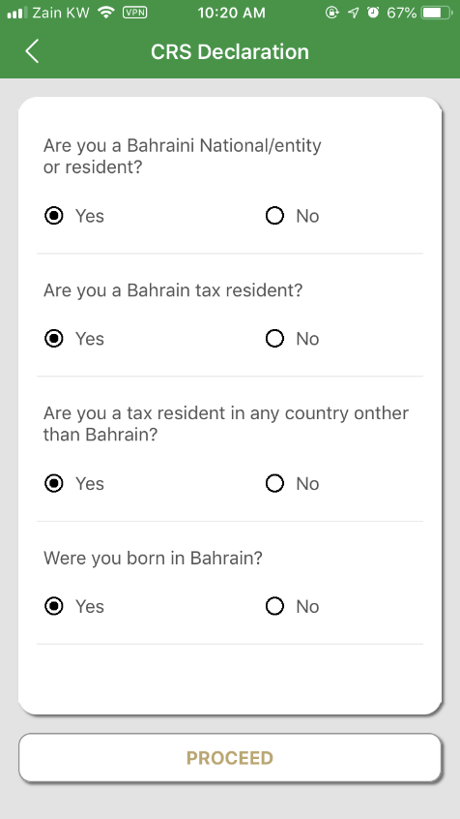
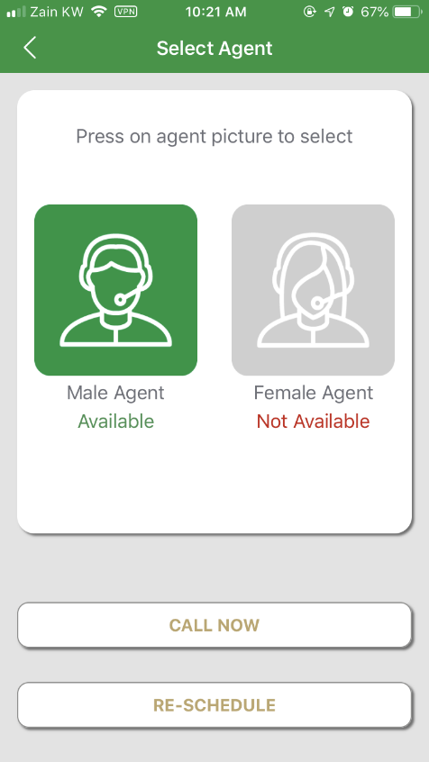

Our
WAYS IN Digitalizing Operations
Customer Onboarding on Mobile

Slide 13
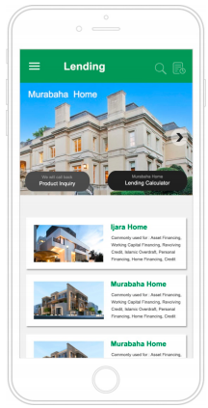
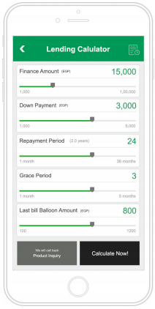
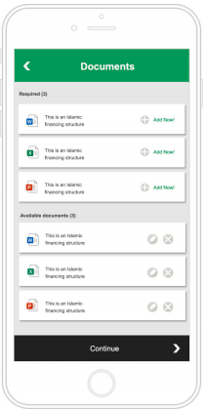
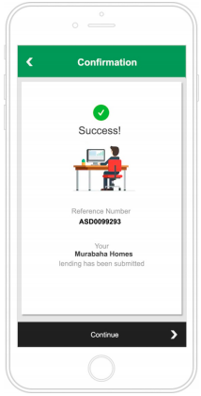
Our
WAYS IN Digitalizing Operations
  E-Finance/ Lending Platform (Web & Mobile Application)

Slide 14

Our
ETHIX Digital Suite

Slide 15

THANK YOU

